Slide 1

Session 7 - Python

Slide 2

Overview
Review of Basics
Extending the Snake
The Pythonic Way
Pandas Data Wrangling
PyODBC Data Base Connector
MatPlotLib Visuals
Scikit-Learn Machine Learning

Slide 3
Review of Basics
Environments
Basic Properties
Variables
Comments
Collections
Conditionals
Loops
Functions

Slide 4

Review of Basics
Environments
IDLE
Included with Python
Anaconda
Spyder GUI
Iron Python console
IDLE console
Includes many packages
Plugins for Visual Studio
PyCharm
Jupyter
Server based – can run online
Coursera runs this

Slide 5
Review of Basics
Basic Properties of Python

Slide 6

Review of Basics
Basic Properties of Python – QUIZ
Compiled or Interpreted?
Typing discipline
Declarative or Imperative

Slide 7
Review of Basics
Basic Properties of Python
Compiled or Interpreted: Interpreted
Can also be compiled
Typing discipline:
Duck-typed
Dynamic
Declarative or Imperative: Imperative Language

Slide 8
Review of Basics
Variables
Define variables by setting the values
Integers
Int_val = 5
Long
long_val = 1204802137402893748902137489
“unlimited” precision
Float
Float_val = 2.5
Strings
String_val = “this is a string, brah”
string_val = ‘this is also a string, brah’

Slide 9

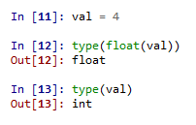
Review of Basics
Variables
Getting the type
type() function
Conversions
type name, followed by value to convert in parenthesis
float(int_val)
str(double_val)

Slide 10
Review of Basics
Comments
#
Single-line comment
“”” “”” or ‘’’ ‘’’
Designed for documentation sections
Can work as a block-style comment for testing

Slide 11
Review of Basics
Collections
tuple
Set and access elements with ()
Analogous to array, value-type collection
Tuple is mathematical set of numbers
list
Set and access elements with []
reference-type collection
dictionary
Set with {}
Access elements with []
Hash table, name:value pair

Slide 12

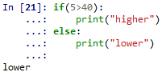
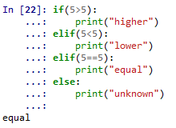
Review of Basics
Conditionals
if
if-else
if-elif
if-elif-else
switch
Not implemented, must use dictionaries in a function
Why did we do this?

Slide 13
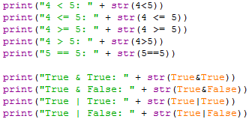
Review of Basics
Conditionals
Logical operators examples

Slide 14



Review of Basics
Loops
for
Loops through each element in a collection
Use range() to get a quick list of elements

Slide 15
Review of Basics
Loops
while
See next slide

Slide 16
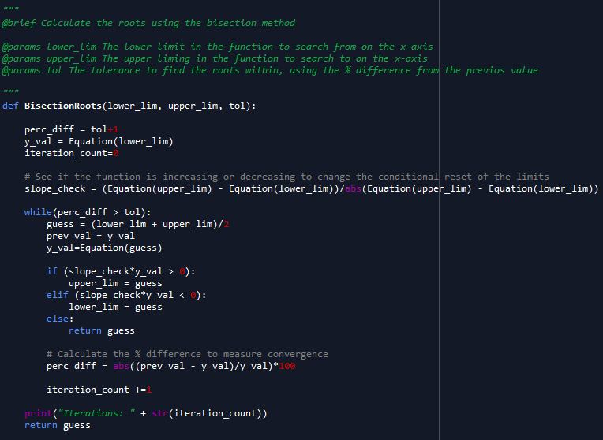
Review of Basics

Slide 17
Review of Basics
Functions
def <function_name>(parameter_list):
<body of function>
return <optional_return_val>

Slide 18
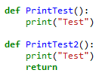
Review of Basics
Functions
Void Functions
Omit the “return” at the end
Include the “return”, but don’t put anything to return
Both methods do the same thing
Setting a variable equal to the functions produces the same type and value output

Slide 19
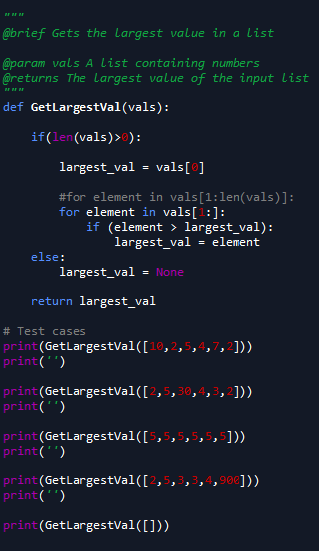
Review of Basics
Functions
Why did we do this?

Slide 20

Review of Basics
Functions

Slide 21

The Pythonic Way
Readability
Tabs vs {}
Explicit Code vs Implicit
*args/**kwargs vs list of each parameter
Built-in mechanism for documentation “”” “””
List Comprehensions
Setting Up Loops
Mathematical Basis

Slide 22

LICENSE
Copyright 2018 Douglas Bowman
Permission is hereby granted, free of charge, to any person obtaining a copy of this software and associated documentation files (the "Software"), to deal in the Software without restriction, including without limitation the rights to use, copy, modify, merge, publish, distribute, sublicense, and/or sell copies of the Software, and to permit persons to whom the Software is furnished to do so, subject to the following conditions:
The above copyright notice and this permission notice shall be included in all copies or substantial portions of the Software.
THE SOFTWARE IS PROVIDED "AS IS", WITHOUT WARRANTY OF ANY KIND, EXPRESS OR IMPLIED, INCLUDING BUT NOT LIMITED TO THE WARRANTIES OF MERCHANTABILITY, FITNESS FOR A PARTICULAR PURPOSE AND NONINFRINGEMENT. IN NO EVENT SHALL THE AUTHORS OR COPYRIGHT HOLDERS BE LIABLE FOR ANY CLAIM, DAMAGES OR OTHER LIABILITY, WHETHER IN AN ACTION OF CONTRACT, TORT OR OTHERWISE, ARISING FROM, OUT OF OR IN CONNECTION WITH THE SOFTWARE OR THE USE OR OTHER DEALINGS IN THE SOFTWARE.

